Slide 1
WELCOME
TO OUR PRESENTATION

Slide 2

Impact Of Rising Commodities Prices Due To Russia-Ukraine War On Government And Non-government Employees
Presented By
Student ID: ST 19026
Student ID: ST 19052
Department of Statistics
Mawlana Bhashani Science and Technology University

Slide 3
outline
Introduction
Objectives
Limitations
Literature Review
Research Methodology
Data and Variable
Results and Discussion
Conclusion
Recommendations
References

Slide 4
Introduction
The Russia-Ukraine conflict is causing global poverty and food insecurity, affecting 27.2 million people and impacting agrifood systems, leading to further poverty and hunger.
The Russian-Ukrainian War has exacerbated the Covid-19 pandemic, economic slowdown, and supply chain disruptions, affecting both industrialized and developing nations, and exacerbated rising food, energy, and commodity costs.
Rising commodity prices, especially gas and oil, impact economies differently based on exporter or importer status, causing dynamic, short- and long-term effects on affected economies.
Exchange rate channels impact macroeconomic outcomes of commodity price shocks, as rising prices and export earnings strengthen exporting nations' currencies, affecting sectors like manufacturing and production-focused regions.

Slide 5
Objectives
To find out the impact of commodities prices due to Russia-Ukraine war.
To explore the impact of commodities prices on government and non- government employees by univariate analysis.
To examine the association between rising commodities prices on government and non-government employees due to Russia-Ukraine war.

Slide 6
Limitations
By examining data from Tangail district only, the study may fail to account for regional variation in economic conditions.
The failure of studies to thoroughly investigate the differential effects on public and private employees may overlook the unique vulnerabilities, coping mechanisms, and policy responses within each group, leading to an incomplete understanding of the problem.
Without longitudinal data, research may be unable to capture the cumulative effects of commodity prices on public and private sector employees over time.
The study's concentration on Tangail district may inadvertently bias.

Slide 7
Literature Review
The Russia-Ukraine conflict sanctions negatively impact international financial markets, causing abnormal industrial returns in sanctioned nations to decrease, and equities only decrease around the war's announcement.
The European Union, after the Cold War, aimed for a united foreign policy through economic sanctions and military operations under Common Security and Defense Policy.
The Russia-Ukraine conflict is expected to cost $1.5 trillion in 2022, impacting 1% of the world's GDP, with Europe most affected due to its commercial ties.
The ongoing Russian-Ukrainian war could increase acute hunger by 47 million people globally, primarily from vulnerable and food-insecure regions, due to increased food prices.

Slide 8
methodology
Research Methodology:
Study Area : Tangail
Sample Design : Stratified Sampling
Sample Size : 250
Data Collection : Questionnaire Method
Statistical Analysis: Univariate Analysis and Bivariate Analysis
Analysis Tool: RStudio, SPSS

Slide 9
Data and variables
Dependent Variable : Job Status
Independent Variable :
No of family members
No of earning members
Monthly income
Monthly expenditure
Monthly savings
Affected commodity prices
Disposable income of employees
Changes in their spending habits
Impact on job satisfaction
Seeking additional sources of income
Financial planning and savings habits
Relocating or changing jobs
Retirement plans or investments
Mitigate the financial impact of rising commodity
Perceptions of inflation and economic stability changed
Engaging in collective bargaining or labor actions
Mental health and well-being of employees
Financial insecurity
Further education or skill development
Optimistic about their long-term financial prospects

Slide 10
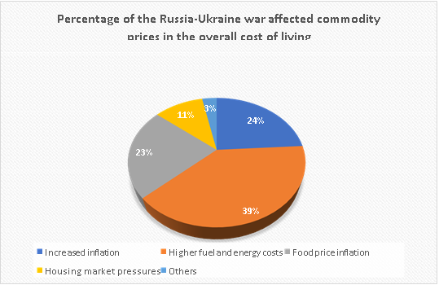
Univariate Analysis
Category | Frequency | Percentage
Increased inflation | 60 | 24
Higher fuel and energy costs | 98 | 39
Food price inflation | 57 | 23
Housing market pressures | 27 | 11
Others | 8 | 3

Slide 11
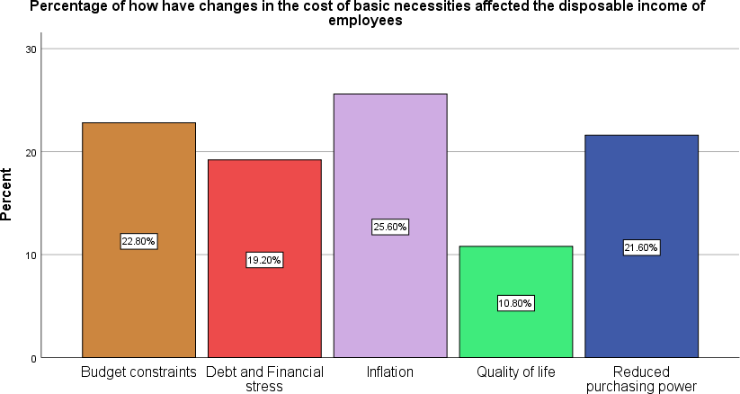
Univariate Analysis
Category | Frequency | Percentage
Reduced purchasing power | 51 | 21.60
Inflation | 62 | 25.60
Budget constraints | 56 | 22.80
Debt and Financial stress | 48 | 19.20
Quality of life | 33 | 10.80

Slide 12
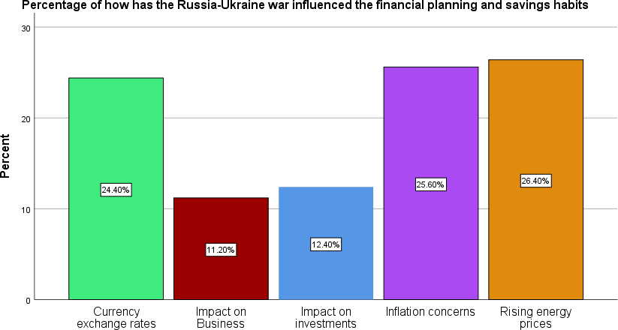
Univariate Analysis
Category | Frequency | Percentage
Currency exchange rates | 61 | 24.4
Impact on Business | 28 | 11.2
Impact on investments | 31 | 12.4
Inflation concerns | 64 | 25.6
Rising energy prices | 66 | 26.4

Slide 13
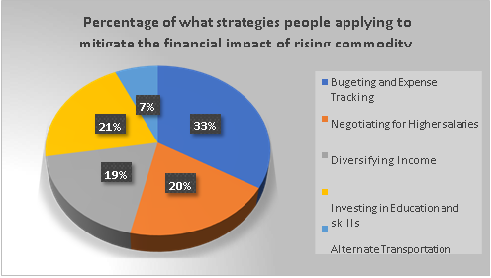
Univariate Analysis
Category | Frequency | Percentage
Alternate Transportation and Energy Options | 17 | 7
Budgeting and Expense Tracking | 79 | 33
Diversifying Income | 48 | 19
Investing in Education and Skills | 55 | 21
Negotiating for Higher Salaries | 51 | 20

Slide 14
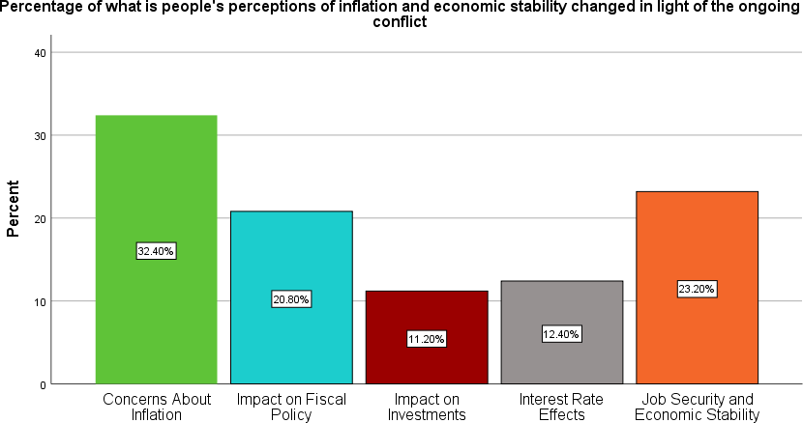
Univariate Analysis
Category | Frequency | Percentage
Concerns About Inflation | 81 | 32.4
Impact on Fiscal Policy | 52 | 20.8
Impact on Investments | 28 | 11.2
Interest Rate Effects | 31 | 12.4
Job Security and Economic Stability | 58 | 23.2

Slide 15
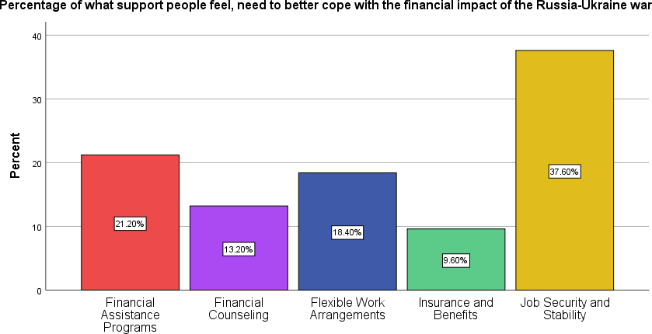
Univariate Analysis
Category | Frequency | Percentage
Financial Assistance Programs | 53 | 21.2
Financial Counseling | 33 | 13.2
Flexible Work Arrangements | 46 | 18.4
Insurance and Benefits | 24 | 9.6
Job Security and Stability | 94 | 37.6

Slide 16
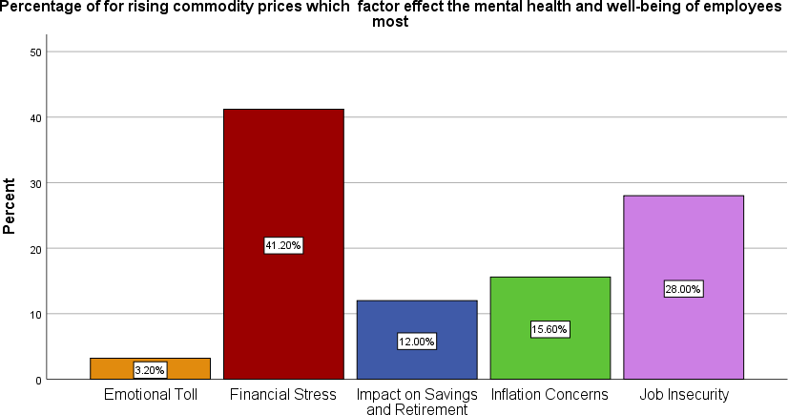
Univariate Analysis
Category | Frequency | Percentage
Emotional Toll | 8 | 3.2
Financial Stress | 103 | 41.2
Impact on Savings and Retirement | 30 | 12.0
Inflation Concerns | 39 | 15.6
Job Insecurity | 70 | 28.0

Slide 17
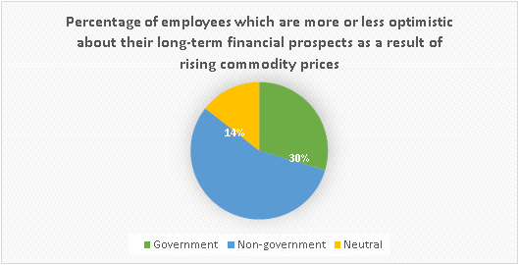
Univariate Analysis
Category | Frequency | Percentage
Government | 76 | 30
Neutral | 37 | 14
Non-government | 137 | 56

Slide 18
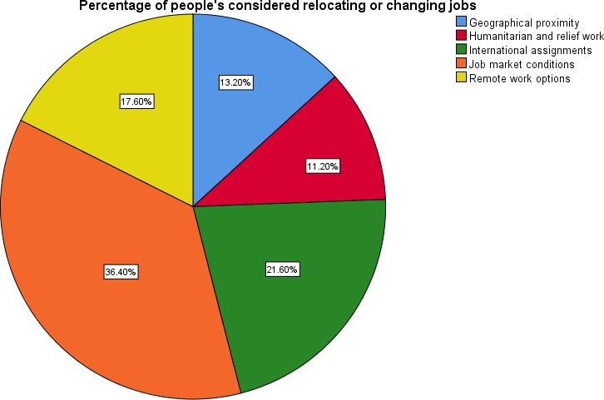
Univariate Analysis
Category | Frequency | Percentage
Geographical proximity | 33 | 13.2
Humanitarian and relief work | 28 | 11.2
International assignments | 54 | 21.6
Job market conditions | 91 | 36.4
Remote work options | 44 | 17.6

Slide 19
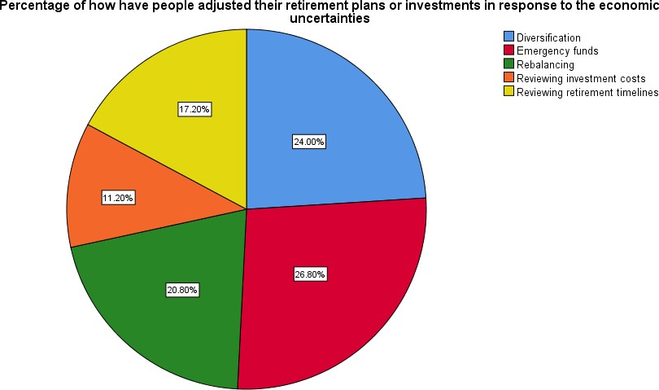
Univariate Analysis
Category | Frequency | Percentage
Diversification | 60 | 24.0
Emergency funds | 67 | 26.8
Rebalancing | 52 | 20.8
Reviewing investment costs | 28 | 11.2
Reviewing retirement timelines | 43 | 17.2

Slide 20
Bivariate analysis
Bivariate Analysis: Representation of Measures of association between dependent variable and predictor variables
Variables | Categories | Job Status |  |  | 𝝌𝟐 (𝑑𝑓) | P-value
 |  | Government (%) | Non- Government (%) | Total
Job satisfaction | Financial stress | 20(28.5) | 50(71.5) | 70
 | Salary expectations Inflation and wage adjustments | 16(21.7) 28(36.1) | 39(78.3) 49(63.9) | 55 77 | 8.722 (4) | 0.068
 | Job insecurity | 5(15.1) | 28(84.9) | 33
 | Productivity and focus | 8(53.2) | 7(46.8) | 15
Here we can see that, Chi-square (𝝌𝟐) goodness of fit statistic indicates that the job satisfaction of the respondents are found to be significant (p-value = 0.068). So, we may reject the null hypothesis. That is, there is an association between job satisfaction and job status due to Russia-Ukraine war and 93.2% respondents feel that job status has affected their job satisfaction.

Slide 21
Bivariate analysis
Representation of Measures of association between dependent variable and predictor variables :
Variables | Categories | Job Status |  |  | 𝝌𝟐 (𝑑𝑓) | P-value
 |  | Government (%) | Non- Government (%) | Total
Seeking | Part time jobs | 10(20) | 40(80) | 50
additional | Freelancing and consulting | 15(21.8) | 54(78.2) | 69 | 17.633
sources of income | Online side hustles | 7(21.9) | 26(78.1) | 33 | (4) | 0.001
 | Renting out property | 21(48.9) | 22(51.1) | 43
 | Investments | 24(43.9) | 31(56.1) | 55
Here we can say that, Chi-square (𝝌𝟐) goodness of fit statistic indicates that seeking additional sources of income of the respondent are found to be significant (p- value = 0.001). So, we may reject the null hypothesis. That is, there is an association between seeking additional sources of income and job status due to Russia-Ukraine war and 99.9% respondents feel that seeking additional sources of income has an impact on job status.

Slide 22
Bivariate analysis
Representation of Measures of association between dependent variable and predictor variables :
Variables | Categories | Job Status |  |  | 𝝌𝟐 (𝑑𝑓) | P- value
 |  | Government (%) | Non- Government (%) | Total
Perception of inflation on economic stability | Concerns about inflation | 29(35.9) | 52(64.1) | 81
 | Impact on fiscal policy | 17(32.7) | 35(67.3) | 52
 | Interest rate effects | 14(45.2) | 17(54.8) | 31 | 10.5 (4) | 0.033
 | Impact on investments | 8(28.6) | 20(71.4) | 28
 | Job security and economic stability | 9(15.6) | 49(84.4) | 58
Here we can say that, Chi-square (𝝌𝟐) goodness of fit statistic indicates that perception of inflation on economic stability of the respondent are found to be significant (p-value = 0.033). So, we may reject the null hypothesis. That is, there is an association between perception of inflation and economic stability and job status due to Russia-Ukraine war and 96.7% respondents feel that perception of inflation and economic stability has an impact on job status.

Slide 23
Bivariate analysis
Representation of Measures of association between dependent variable and predictor variables :
Variables | Categories | Job Status |  |  | 𝝌𝟐 (𝑑𝑓) | P-value
 |  | Government (%) | Non- Governmen t (%) | Total
Financial support | Financial assistance programs | 19(35.9) | 34(64.1) | 53
 | Job security and stability Flexible work arrangements | 20(21.3) 15(32.7) | 74(78.7) 31(67.3) | 94 46 | 7.178 (4) | 0.127
 | Financial counseling | 13(39.4) | 20(60.6) | 33
 | Insurance and benefits | 10(41.7) | 14(58.3) | 24
From table 6.9, Chi-square (𝝌𝟐) goodness of fit statistic indicates that financial support of the respondents are found to be significant (p-value = 0.127). So, we may reject the null hypothesis. That is, there is an association between financial support and job status due to Russia-Ukraine war and 87.3% respondents feel that financial support has an impact on job status.

Slide 24
Bivariate analysis
Representation of Measures of association between dependent variable and predictor variables :
Variables | Categories | Job Status |  |  | 𝝌𝟐 (𝑑𝑓) | P-value
 |  | Government (%) | Non- Governmen t (%) | Total
Mental health or well-being | Financial stress | 29(28.2) | 74(71.8) | 103
 | Job insecurity Inflation concerns | 12(17.2) 16(41.1) | 58(82.8) 23(58.9) | 70 39 | 16.908 (4) | 0.002
 | Impact on savings and retirement | 16(53.4) | 14(46.6) | 30
 | Emotional toll | 4(50) | 4(50) | 8
Here we can see that, Chi-square (𝝌𝟐) goodness of fit statistic indicates that mental health or well-being of the respondent are found to be significant (p-value = 0.002). So, we may reject the null hypothesis. That is, there is an association between mental health and well-being and job status due to Russia-Ukraine war

Slide 25
conclusion
The study shows that about 84.4% of respondents out of 250 participants believe that the Russia-Ukraine conflict significantly affects global affairs.
Most respondents believe that the Russia-Ukraine war is affecting commodity prices, employee’s disposable income, mental health, and employees seeking financial assistance to cope.
From the bivariate analysis, there is a significant relationship between job status and various independent variables, including monthly income, monthly expenditure, seeking additional sources of income, financial support, mental health, job satisfaction, and perception of inflation on economic stability, among others.

Slide 26
recommendations
Invest in renewable energy sources to reduce reliance on imported fuels and mitigate future price shocks.
Promote local production of essential goods to enhance self-sufficiency and reduce vulnerability to global market fluctuations.
Improve supply chain resilience to mitigate the impact of global disruptions on local commodity prices.
Encourage diversification of import sources to reduce dependency on conflict-affected regions
Governments should implement macroeconomic policies to control inflation, such as adjusting interest rates and controlling money supply.
Encourage remote work to reduce commuting costs for employees, especially given the high fuel prices

Slide 27
references
Abay, Kibrom A., Clemens Breisinger, Joseph Glauber, Sikandra Kurdi, David Laborde, and Khalid Siddig. 2023. ‘The Russia-Ukraine War: Implications for Global and Regional Food Security and Potential Policy Responses’. Global Food Security 36:100675. doi: 10.1016/j.gfs.2023.100675.
Arndt, Channing, Xinshen Diao, Paul Dorosh, Karl Pauw, and James Thurlow. 2023. ‘The Ukraine War and Rising Commodity Prices: Implications for Developing Countries’. Global Food Security 36:100680. doi: 10.1016/j.gfs.2023.100680.
Chen, Yang, Liang Cheng, Chien-Chiang Lee, and Chang-song Wang. 2021. ‘The Impact of Regional Banks on Environmental Pollution: Evidence from China’s City Commercial Banks’. Energy Economics 102:105492. doi: 10.1016/j.eneco.2021.105492.

Slide 28
Thank You

Slide 29
Any Questions?

